Slide 1
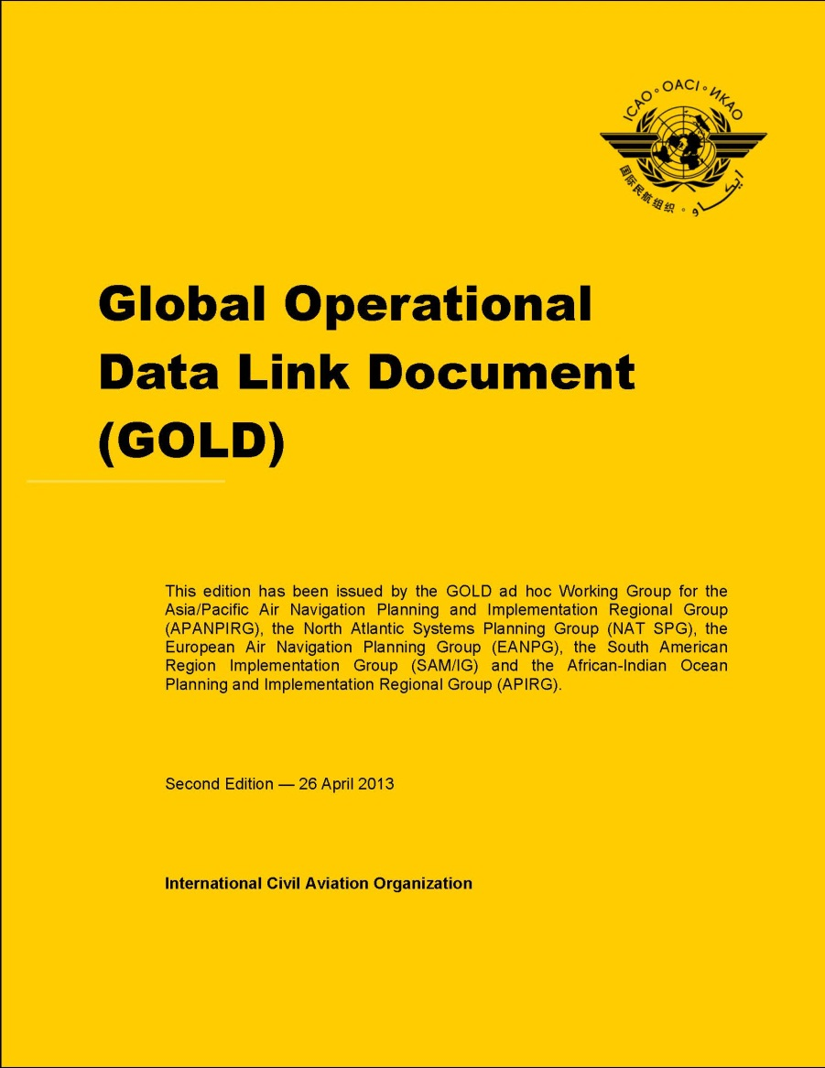
Global Operational Data Link Document (GOLD)
Second (2nd) Edition
Presented to:
Seventeenth Meeting of the Communications, Navigation, Surveillance Sub-Group (CNS SG/17) of APANPIRG
By: Tom Kraft tom.kraft@faa.gov
Date: 13-17 May 2013

Slide 2
GOLD introduction
GOLD ad hoc Working Group established in 2008 (APANPIRG 19/9 and NAT SPG 44/9)
To develop common Performance-Based Data Link Guidance Material, which later became GOLD
After completion in June 2010, the North Atlantic (NAT) and Asia-Pacific (APAC) Regions adopted the Global Operational Data Link Document (GOLD), First (1st) Edition

Slide 3
GOLD recognition
“GOLD is a very significant step towards the global harmonization of ADS-C and CPDLC procedures for pilots and air traffic controllers.” – Mokhtar A. Awan
Ref. T 3110.0 -AP108/10 (ATM), 28 June 2010
The GOLD now supersedes both the
NAT Data Link Guidance Material and
FANS 1/A Operations Manual (FOM)

Slide 4
GOLD amendment program
Nov 2010 – EANPG approved amendment program to support data link implementation in the EUR Region
Amendment program will allow GOLD to be applicable to ATS data link worldwide
GOLD ad hoc WG was tasked with the work
Solicited and coordinated proposals for amendment
Interpreted GOLD guidance in its application
Facilitated implementation of data link

Slide 5
EUR Region plans to endorse GOLD
Amendments were needed to support EUR Region implementing rule for data link services
Operational differences – airspace where ATS surveillance services are provided (domestic) versus airspace where procedural separations are applied (oceanic and remote)
Technical differences – ATN B1 (LINK 2000+ CPDLC) versus FANS 1/A (CPDLC and ADS-C)
Ensure amendments are globally acceptable

Slide 6
Participating ICAO Regions
Bangkok (APAC) – Asia / Pacific Regions
Paris (EUR-NAT) – European / North Atlantic Regions
Lima (SAM) – South American Region
Dakar (AFI) – African – Indian Ocean Region
Mexico (CAR) – Caribbean Region
And also North American (NAM) Region

Slide 7
Participating international organizations and industry
ICAO Montreal - Headquarters (OPLINKP)
IATA, IFALPA and operators / pilots
CANSO, IFATCA, ANSPs and controllers
IBAC, IGA and general aviation community
ATS system suppliers
Aircraft manufacturers / equipment suppliers
CSPs and satellite service providers (SSPs)

Slide 8
GOLD Working Group
120+ GOLD website subscribers
56 different organizations from 27 different countries
AUSTRALIA | MALAYSIA | RUSSIAN FEDERATION
BELGIUM | MEXICO | SENEGAL
CANADA | NETHERLANDS | SINGAPORE
FRANCE | NEW ZEALAND | SPAIN
GERMANY | OMAN | THAILAND
ICELAND | PERU | TUNISIA
ITALY | PORTUGAL | UNITED ARAB EMIRATES
JAPAN | REPUBLIC OF KOREA | UNITED KINGDOM
LIBYA | ROMANIA | UNITED STATES

Slide 9
Activity since GOLD 1st Edition
10-14 Oct 2011 – GOLD/4 in Paris, France – 27 attended
21 Oct 2011 – GOLD v1.1 Working Draft
9 May 2012 – GOLD Web 4.1 – 17 attended
14 May 2012 – GOLD v1.2 Working Draft
10-15 Jun 2012 – GOLD/5 in Miami – 28 attended
30 Jun 2012 – GOLD v1.3 Working Draft
17 Oct 2012 – GOLD Web 5.1 – 23 attended
4 Nov 2012 – GOLD v1.4 Working Draft
18 Jan 2013 – GOLD v1.4.1 Working Draft
28 Jan to 4 Feb 2013 – GOLD/6 in Phoenix – 38 attended
4 Feb 2013 – GOLD v1.4.4 Working Draft
16 Feb 2013 – GOLD v1.5 Final Draft
26 April 2013 ➔ GOLD 2nd Edition

Slide 10
GOLD, 2nd Edition, trailer (1 of 2)
Applies to FANS 1/A, ATN B1 and FANS 1/A­-ATN B1 aircraft and ground systems in all airspace
Where procedural separations are applied
Where ATS surveillance services are provided
Generalized Chapter 2 data link description
Common procedures (for most part) in Chapter 4-6
Addresses High Level Safety Conference (HLSC) recommendations (AN 13/2.5-13/16, 15 March 2013)
Data link initiation failure procedure (not CPDLC initiation)
For ADS-C conformance monitoring

Slide 11
GOLD, 2nd Edition, trailer (2 of 2)
Added advanced air traffic services supported by data link
CPDLC for ATC-initiated re-route procedure
CPDLC for ADS-B in trail procedure (ITP)
Clarified position reporting requirements in ADS-C environments, e.g. reporting revised time estimates
Annex 2, paragraph 3.6.2.2 c), Doc 7030 and AIP (or other)
Updated Appendix E, Region / State specifics, with new look and includes European Region
Includes guidance on RCP – RSP specifications and post-implementation monitoring

Slide 12
GOLD contents
Information | Introduction, background, scope | Foreword
 | Definitions of terms / acronyms | Chapter 1
 | Data link general familiarization | Chapter 2
Guidelines | Data link service provision | Section 3.1
 | Operator – aircraft preparation | Section 3.2
 | Controller – flight crew procedures | Chapters 4-7
Supporting Guidelines | CPDLC message sets / standardized free text | Appendix A
 | RCP – RSP specifications | Appendices B and C
 | Post-implementation monitoring | Appendix D
 | Region/State & aircraft specifics | Appendices E and F

Slide 13
Comment summary
GOLD Chapter | Total Comments
General | 20
Foreword | 12
1 | 12
2 | 405
3 | 50
4 | 286
5 | 234
6 | 56
7 | 1
GOLD Chapter | Total Comments
Apx A | 21
Apx B | 5
Apx C | 1
Apx D | 24
Apx E | 60
Apx F | 9
Total | 1196

Slide 14
GOLD, 2nd Edition, adoption
North Atlantic – NAT SPG – Jun 2013
Asia – Pacific – APANPIRG – Jun 2013
European – EANPG - Nov 2013
Propose to supersede LINk2000+ guidance docs
South American – SAM/IG – Oct 2013?
African – Indian Ocean – APIRG – Mar 2014?

Slide 15
Following adoption
GOLD will provide basis for global harmonization of data link operations
Regions should promulgate GOLD (2nd Edition) to the air navigation service providers and operators to facilitate data link implementation and use
GOLD ad-hoc working group stands ready to assist the ICAO Regional and Headquarters Secretariats on any potential future amendments to the GOLD, as required
ICAO OPLINKP and Regions should coordinate to convert GOLD into a ICAO HQ Manual (Doc GOLD)

Slide 16
Summary
June 2010 ➔ GOLD (1st Edition) was a very significant step towards the global harmonization of ADS-C and CPDLC procedures for pilots and air traffic controllers
mainly using FANS 1/A in procedurally controlled airspace
April 2013 ➔ GOLD (2nd Edition) intended to become applicable to existing and near term ADS-C and CPDLC implementations throughout the world
including ATN B1 (Link 2000+) and airspace where ATS surveillance services are provided

Slide 17
Action by the meeting
(slightly modified from WP/18 ➔ GOLD, 2nd Edition)
3.1 The APANPIRG CNS and ATM SGs are invited to:
note the information provided;
review and comment on GOLD, 2nd Edition, as provided at Appendix A; and
recommend the APANPIRG the approval of the GOLD, 2nd Edition, and consider following draft Conclusion:
Draft Conclusion 17/xx – Adoption of Global Operational Data Link Document (GOLD), 2nd Edition
That, the Global Operational Data Link Document (GOLD), 2nd Edition, provided in the Appendix [XX] to the Report be adopted.

